Slide 1
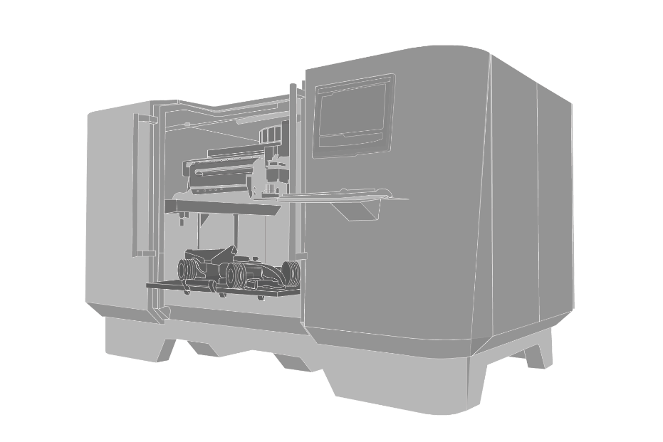
Fabrikam X1050 3D Printer
Make your dreams a reality

Slide 2
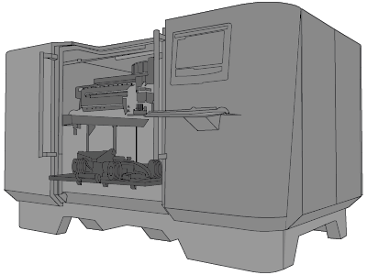
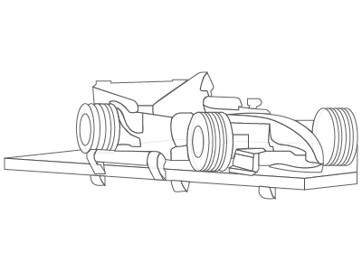
BROCHURE COMPONENTS
X1050 3D Printer
Output image

Slide 3
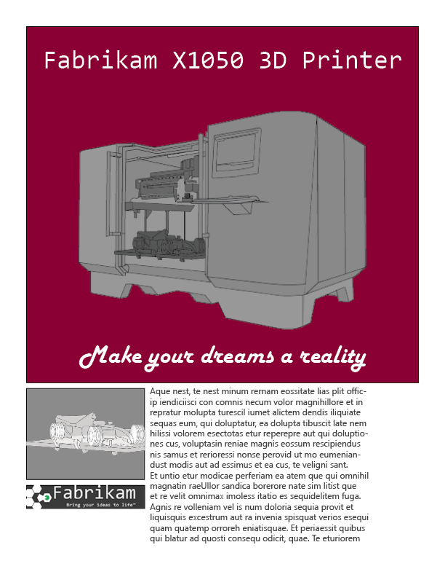
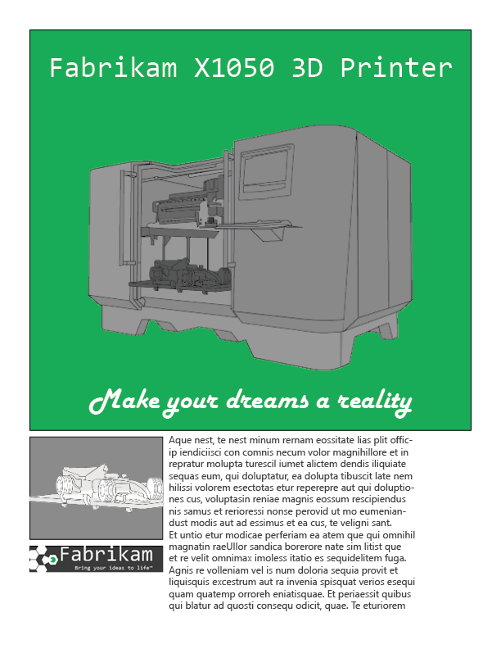
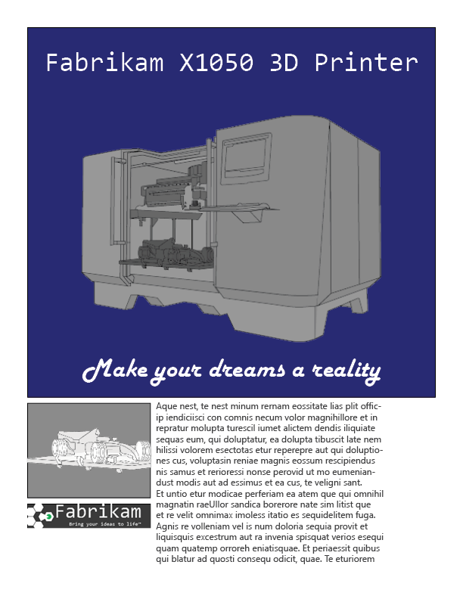
Brick (#8b0033)
Kelly (#1fac59)
Navy (#000080)

Slide 4
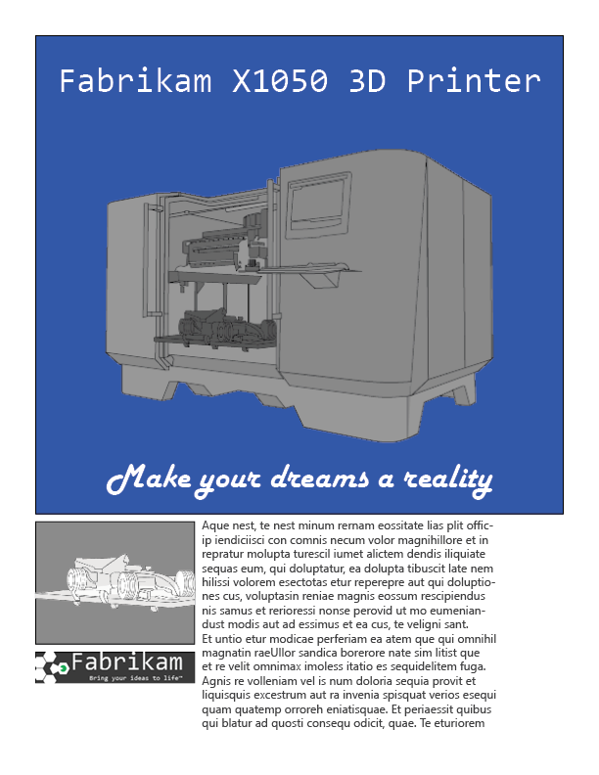





Project Team: Christie Cline Miriam Graham Adele Vance Isiah Langer Alex Wilber
Cerulean (#2956B2)

